Slide 1
Finding Modules in Networks with Non-modular Regions
Sharon Bruckner, Bastian Kayser, Tim Conrad
Freie Uni. Berlin

Slide 2
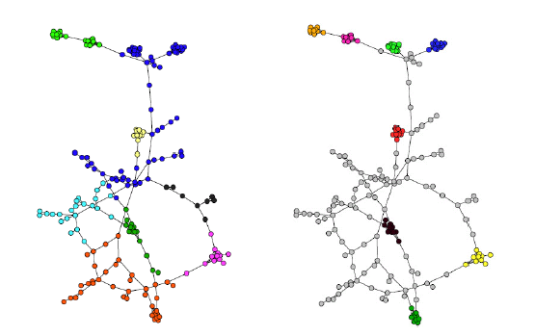
What are networks with non-modular regions?
Can every network be fully partitioned into dense clusters?
We introduce NCC networks.
Modular region
Transition region

Slide 3
Where do NCC networks occur?
The network is actually full partitionable, but contains noise.
The network structure is not strictly modular:Nodes
Overlaps
Outliers
Paths and nodes connecting modules
Example: A protein-protein interaction network

Slide 4
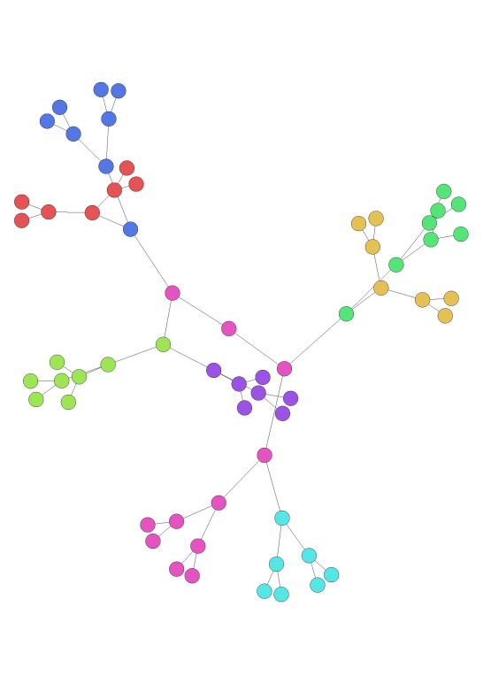
Formalizing this notion of modularity
Goal:
A score that quantifies how modular an NCC network is, analogous to Newman‘s Modularity.
Then:
What‘s wrong with simply taking Newman Modularity?
Answer:
Trees and very sparse graphs have high Newman Modularity
0.75

Slide 5
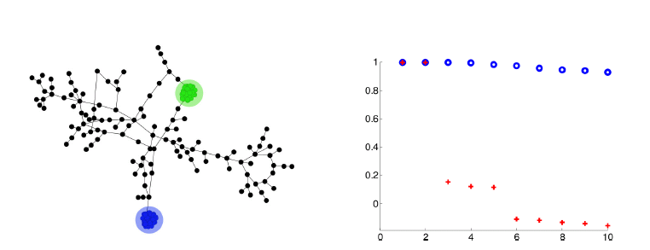
Transition matrices and gaps
In a discrete random walk on a network, the random walker moves at each step to randomly chosen neighbor. This is encoded in the transition matrix.
Clustering algorithms often rely on the gap in the eigenvalue spectrum of the transition matrix.
The presence of eigenvalues close to 1, followed by a gap, indicate the presence of modules.
For NCC networks, this is not enough. Therefore we introduce a transition matrix Pt, that comes from a continuous random walk.

Slide 6
Transition matrices and gaps
Standard transition matrix $P\left(x,y\right)=\frac{1}{deg\left(x\right)}$
Generator L for the continuous random walk process.
There is a waiting time between jumps that is proportional to the degree
Compute the transition matrix $P_{t}$ for time t as $P_{t}=exp⁡\left(tL\right)$

Slide 7
First try: the gap score
Exploit the connection between the number of eigenvalues close to 1 of the transition matrix and the number of modules.
Compute $P_{t}$.
Find the largest difference between two consecutive eigenvalues.
Return as score.

Slide 8
Gap score: Analysis and results
Sparse networks do not have a high gap score
Example: road networks, with Newman modularity ~ 0.95 and gap score of ~ 0.002
Drawback 1: Arbitrariness. There is no one „true“ gap in the spectrum.
Drawback 2: clear gap $→$ existence of modules, but: existence of modules $↛$clear gap
Main Advantage: This is a global score, not dependent on a partition

Slide 9
Second try: metastability score
Motivated by the concept of metastability of physical systems.
A metastable partition of a network into a transition region T and modules $M= \left\{M_{i}\right\}$ satisfies:
$R=time\left(transition region −→modules\right)≪$
$W=time(module −→another module)$
So, the time spent inside the modules should be long, while the time spent inside the transition region should be short.

Slide 10
Second try: metastability score
Motivated by the concept of metastability of physical systems.
A metastable partition of a network into a transition region T and modules $M= \left\{M_{i}\right\}$ satisfies:
$R ≔\max_{y ∉M}{𝔼_{y}\left(τ\left(M\right)\right)≪\min_{i=1…m}{𝔼_{i}\left(τ\left(M_{i}\right)\right)≔W}}$
Where $𝔼_{y}\left(τ\left(M\right)\right)$ is the expected entry time into some module when starting in T, and $𝔼_{i}\left(τ\left(M_{i}\right)\right)$ is the expected entry time into a module when starting in a different module.

Slide 11
Metastability score: Analysis
For a given network and a given partition $\left(M,T\right)$ we can then define the metastability score as $1−R/W$.
Main Drawback: This is a score for a given partition, not global!
The score depends on number of modules m.
Cannot be optimized: For every partition where $T=∅$we will have $R=0$ and therefore an optimal score.
Main Advantage: Explicitly takes into account the transition region, more suited for NCC networks.

Slide 12
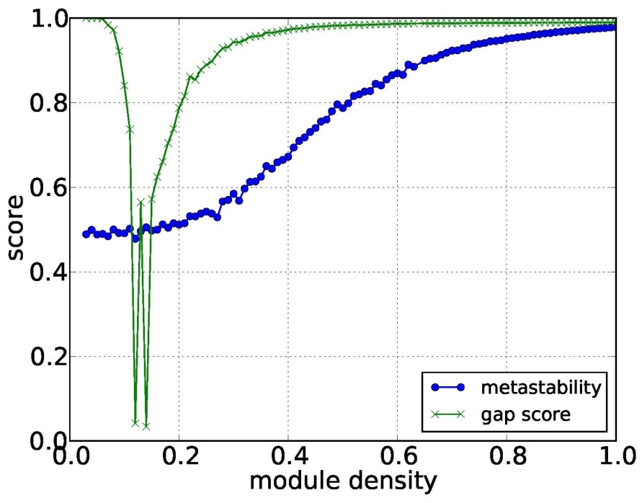
Experiment results on the two scores
For networks with two modules of size 100 with increasing density and a transition region of 1000 nodes.

Slide 13
Intermediate Conclusion
Both scores have some major disadvantages
Currently developing an improved score:
Takes the transition region into account
is provably „good“, at least on some well-defined network classes.
dependent on the partition (so, not global), but the partition can be optimized.

Slide 14
Algorithms for identifying modules in NCC networks
We compare the behavior of 3 algorithms on a benchmark dataset of NCC networks:
MSM: The Markov State Model clustering algorithm first identifies and removes the transition region, and then deterministically clusters the remaining nodes.
SCAN: Clusters nodes together based on neighborhood similarity and reachability. Assigns nodes the roles of hubs, outliers.
MCL: The Markov Clustering algorithm simulates random walks on the network and identifies modules as regions where the random walker stays for a long time. Returns a full partition.

Slide 15
Adjusting the algorithms
Main Adjustment:
Nodes in modules under a threshold 1% of nodes are assigned to the transition region.
For SCAN, outliers and hubs are additionally assigned to the transition region.

Slide 16
How can we evaluate the results?
Benchmark networks:
A parameterized random graph model where:
modules: ER graphs having the same size $N_{m.}$ and connection probability $p_{m.}$
transition region is an ER graph with $\left(N_{T},p_{T}\right)$
The nodes in M and T are then connected w.p $p_{i.}$
Vary ratio of size of M to T, density of M to T.
Networks with 1000 nodes, 5 modules.

Slide 17
How can we evaluate the results?
Evaluation Scores:
Comparing the „ground truth“ partition from the construction of the benchmark set with the partition found by the algorithm .
Construct 3 scores based on the well-known Rand Index
$ρ_{MT}$evaluates how well the algorithms separates the transition region from the modular region
$ρ_{M}$measures the quality of the clustering within the modular region
$ρ_{C}$a combined score.

Slide 18
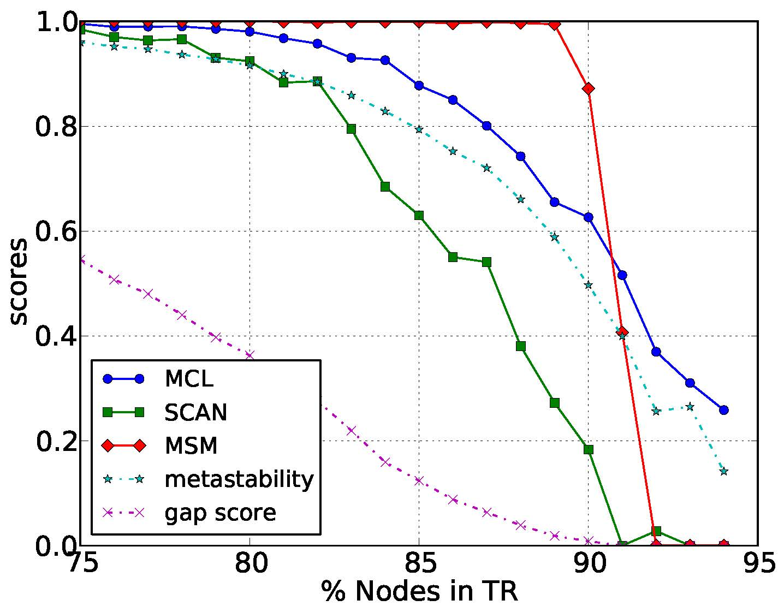
Experiment 1: varying sizes
MSM performs best
Metastability score behaves similiarly to algorithm score
Comparing $ρ_{C}$ score for SCAN, MCL and MSM on networks with varying sizes of T

Slide 19
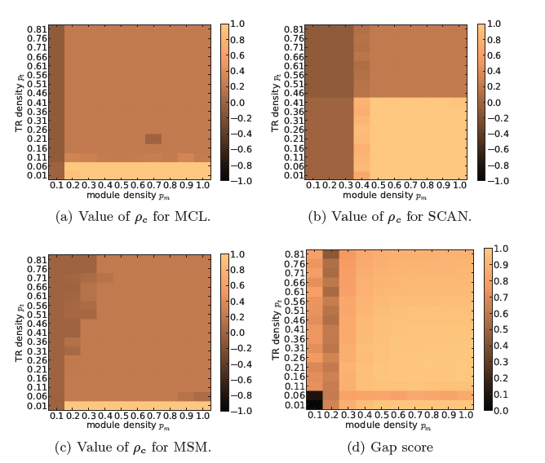
Experiment 2: varying densities of modules and transition region
Plotting $ρ_{C}$ for the 3 algorithms with different combinations of $p_{T}$ and $p_{m}$, along with the gap score

Slide 20
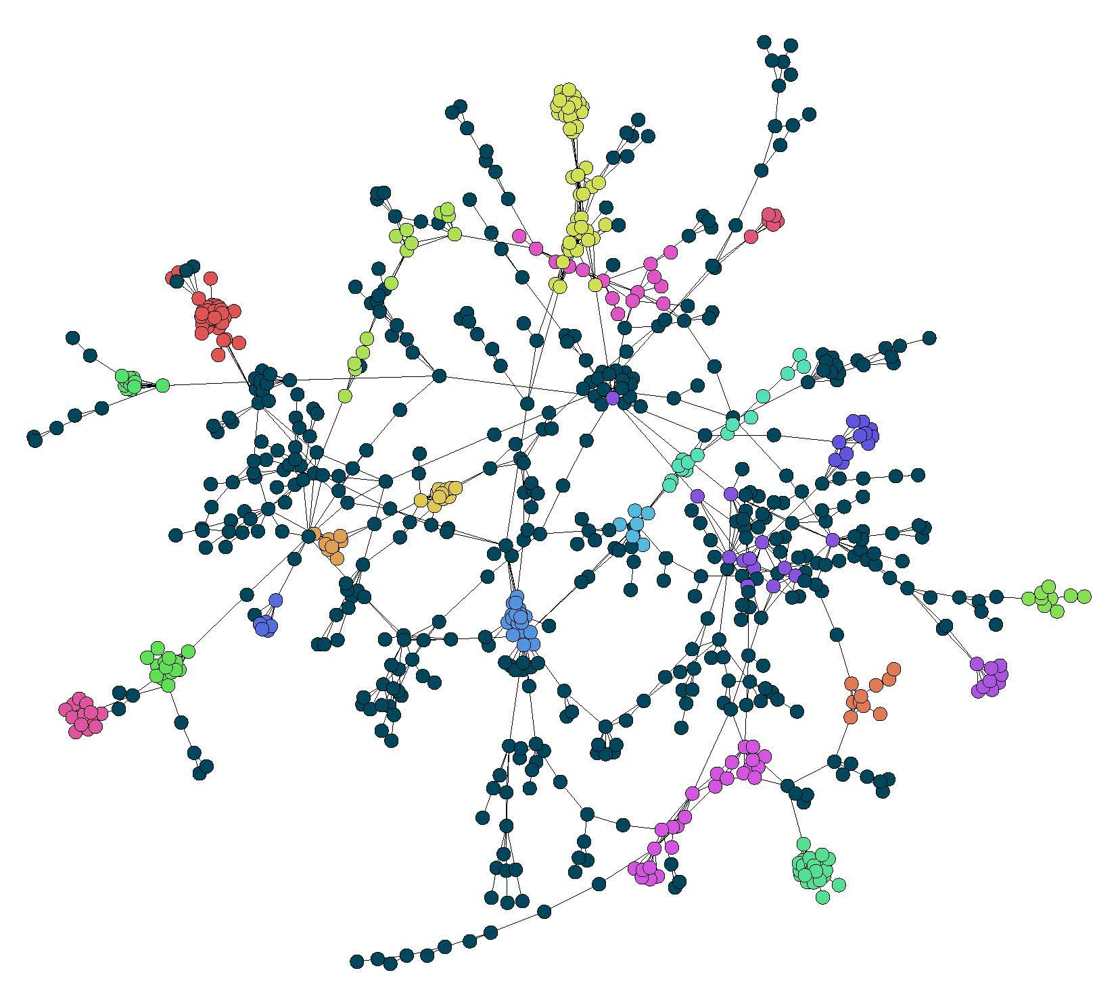
Experiment 3: A PPI network
We identified modules in the yeast FYI network.
Our modules correspond to known protein complexes from the CYC2008 database.
We are working on assigning roles to the nodes in the transition region.

Slide 21
Summary and Outlook
Clustering networks such that not all nodes are assigned to modules is useful.
We presented two scores to quantify how modular a network is, and showed that there is room for improvement.
We compared the performance of 3 algorithms on the task of identifying modules in NCC networks.

